Slide 1
Intro to Petrographic Microscopes B
EPSS 51
Adapted from Greg Druschel, University of Delaware

Slide 2
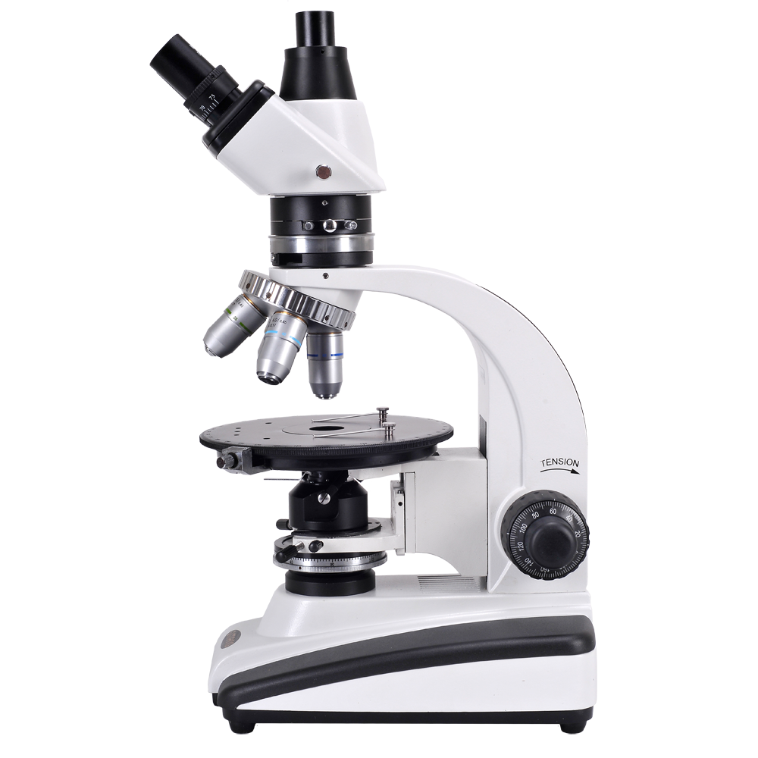
The Petrographic Microscope
Ocular
Analyzer (upper polar)
Bertrand lens (inverts light)
Gypsum plate
Rotating nosepiece
(use to change objectives!)
Objectives (do not touch!)
Arm
Rotating stage
Condenser
Focus
Lower polar
Light source
Notes:
http://www.microscope.com/media/catalog/product/cache/2/image/9df78eab33525d08d6e5fb8d27136e95/o/m/om239p__3_of_5_copy.png

Slide 3
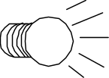


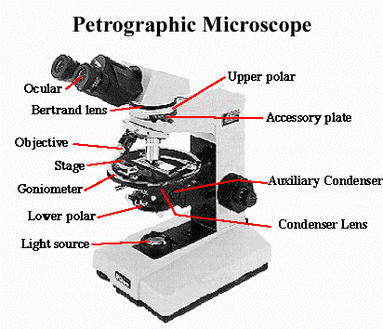
2) Insert the analyzer (upper polarizer)
west (left)
north (back)
south (front)
east (right)
Black!! (“extinct”)
Now what happens?
What reaches your eye?
Why would anyone design a microscope that prevents light from reaching your eye???
XPL=crossed polars

Slide 4
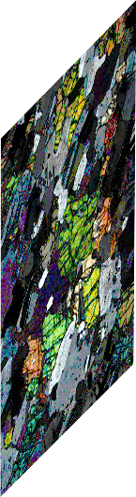
3) Now insert a thin section of a rock
west (left)
Unpolarized light
east (right)
Light and colors reach eye!
Light vibrating E-W
Light vibrating in many planes and with many wavelengths
How does this work??

Slide 5
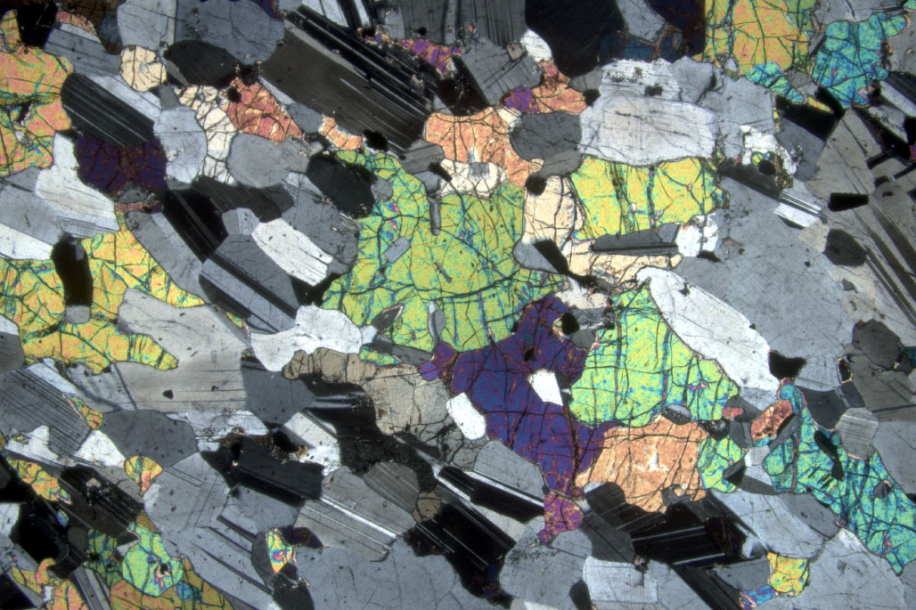
Conclusion has to be that minerals somehow reorient the planes in which light is vibrating; some light passes through the upper polarizer

Slide 6
4) Note the rotating stage
Most mineral grains change color as the stage is rotated; these grains go black 4 times in 360° rotation- exactly every 90º
These minerals are anisotropic
Glass and a few minerals stay black in all orientations:
These minerals are isotropic

Slide 7
Some generalizations and vocabulary
All isometric minerals (e.g., garnet) are isotropic – they cannot reorient light. Light does not get rotated or split; propagates with same velocity in all directions
  These minerals are always black in crossed polars.
All other minerals are anisotropic – they are all capable of reorienting light (transmit light under cross polars).
All anisotropic minerals contain one or two special directions that do not reorient light.
  Minerals with one special direction are called uniaxial
  Minerals with two special directions are called biaxial

Slide 8
How light behaves depends on crystal structure
Isotropic
Uniaxial
Biaxial
Isometric
  All crystallographic axes are equal
Hexagonal, tetragonal
  All axes ⊥ c are equal but c is unique
Orthorhombic, monoclinic, triclinic
  All axes are unequal

Slide 9
Isotropic minerals: light does not get rotated or split; propagates with same velocity in all directions
Anisotropic minerals:
    Uniaxial - light entering in all but one special direction is resolved into 2 plane polarized components that vibrate perpendicular to one another and travel with different speeds
    Biaxial - light entering in all but two special directions is resolved into 2 plane polarized components…
  Along the special directions (“optic axes”), the mineral thinks that it is isotropic - i.e., no splitting occurs
  Uniaxial and biaxial minerals can be further subdivided into optically positive and optically negative, depending on orientation of fast and slow rays relative to xtl axes

Slide 10
‘Splitting’ of light → what does it mean?
For some exceptionally clear minerals where we can see this is hand sample this is double refraction → calcite displays this
Light is split into 2 rays, one traveling at a different speed, and this difference is a function of thickness and orientation of the crystal
ALL anisotropic minerals have this property, and we can ‘see’ that in thin sections with polarized light!

Slide 11
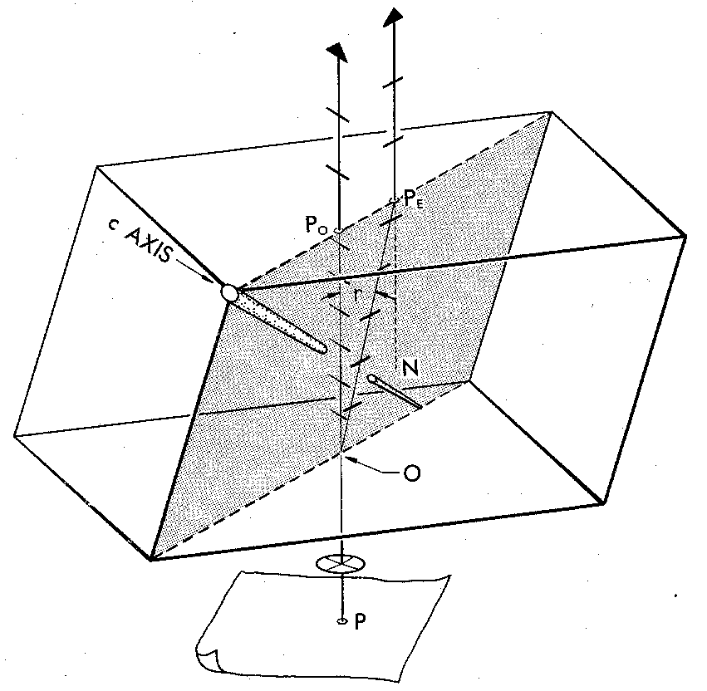
Anisotropic crystals
Calcite experiment and double refraction
O E
O-ray (Ordinary) → ω
Obeys Snell's Law and goes straight
Vibrates ^ plane containing ray and c-axis (“optic axis”)
E-ray (Extraordinary) → ε
deflected
Vibrates in plane containing ray and c-axis
Fig 6-7 Bloss, Optical Crystallography, MSA

Slide 12
IMPORTANT: A given ray of incoming light is restricted to only 2 (mutually perpendicular) vibration directions once it enters an anisotropic crystal
Called privileged directions
Each ray has a different n
  w = n_{o}
  e = n_{E}
  in the case of calcite w < e
…which makes the O-ray dot appear above E-ray dot
Different rays going different speeds means they are at different wavelengths
O E
Fig 6-7 Bloss, Optical Crystallography, MSA

Slide 13
If I slow down 1 ray and then recombine it with another ray that is still going faster, what happens??

Slide 14
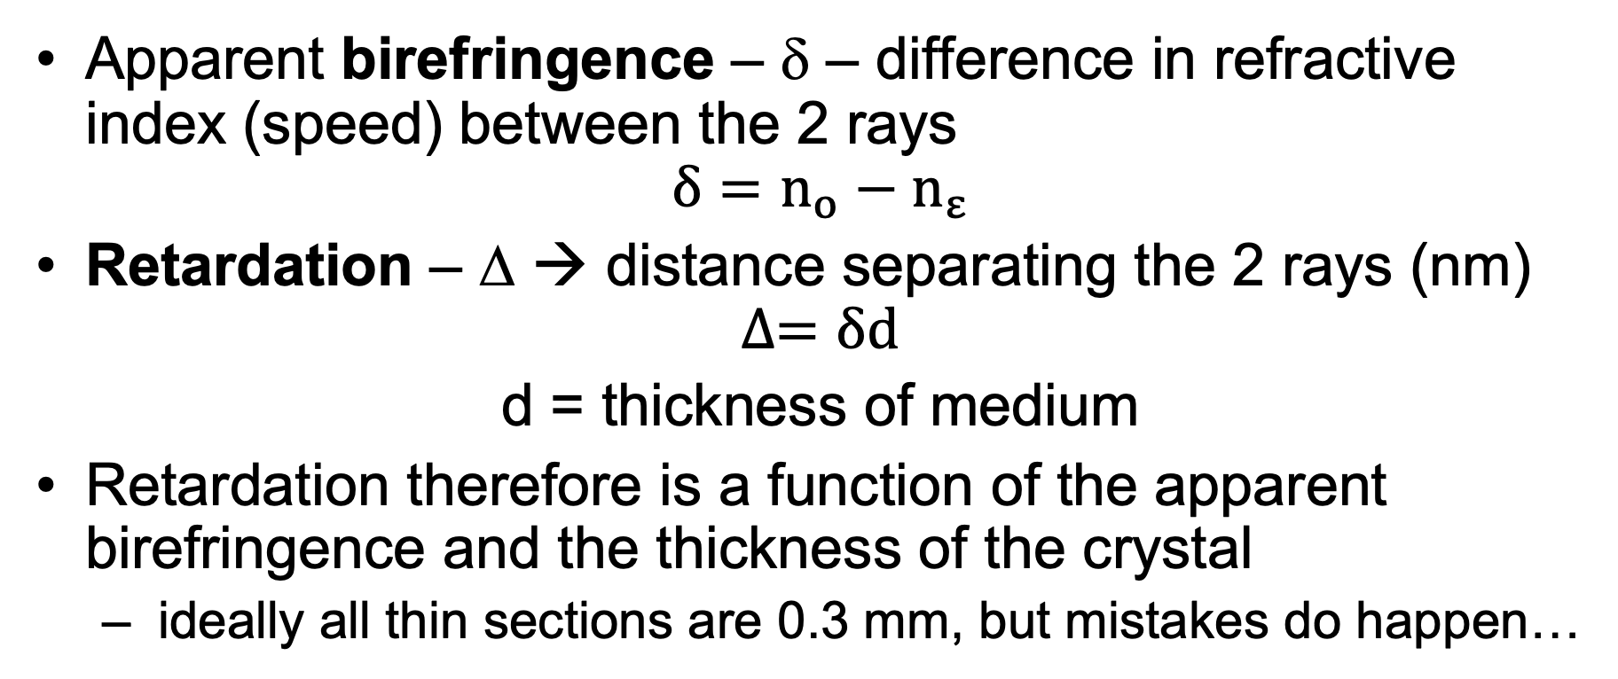
Difference between our 2 rays
Apparent birefringence – δ – difference in refractive index (speed) between the 2 rays
$$δ=n_{o}−n_{ε}$$
Retardation – Δ → distance separating the 2 rays (nm)
$$∆=δd$$
d = thickness of medium
Retardation therefore is a function of the apparent birefringence and the thickness of the crystal
  ideally all thin sections are 0.3 mm, but mistakes do happen…

Slide 15
Polarized light going into the crystal splits into two rays, going at different velocities and therefore at different wavelengths (colors)
one is O-ray with n = w
other is E-ray with n = e
When the rays exit the crystal they recombine
When rays of different wavelength
combine → what things happen?
w
e
polarizer

Slide 17
Estimating birefringence
  1) Find the crystal of interest showing the highest colors (D depends on orientation)
  2) Go to color chart
    thickness = 30 microns
    use 30 micron line + color, follow radial line through intersection to margin & read birefringence

Slide 18
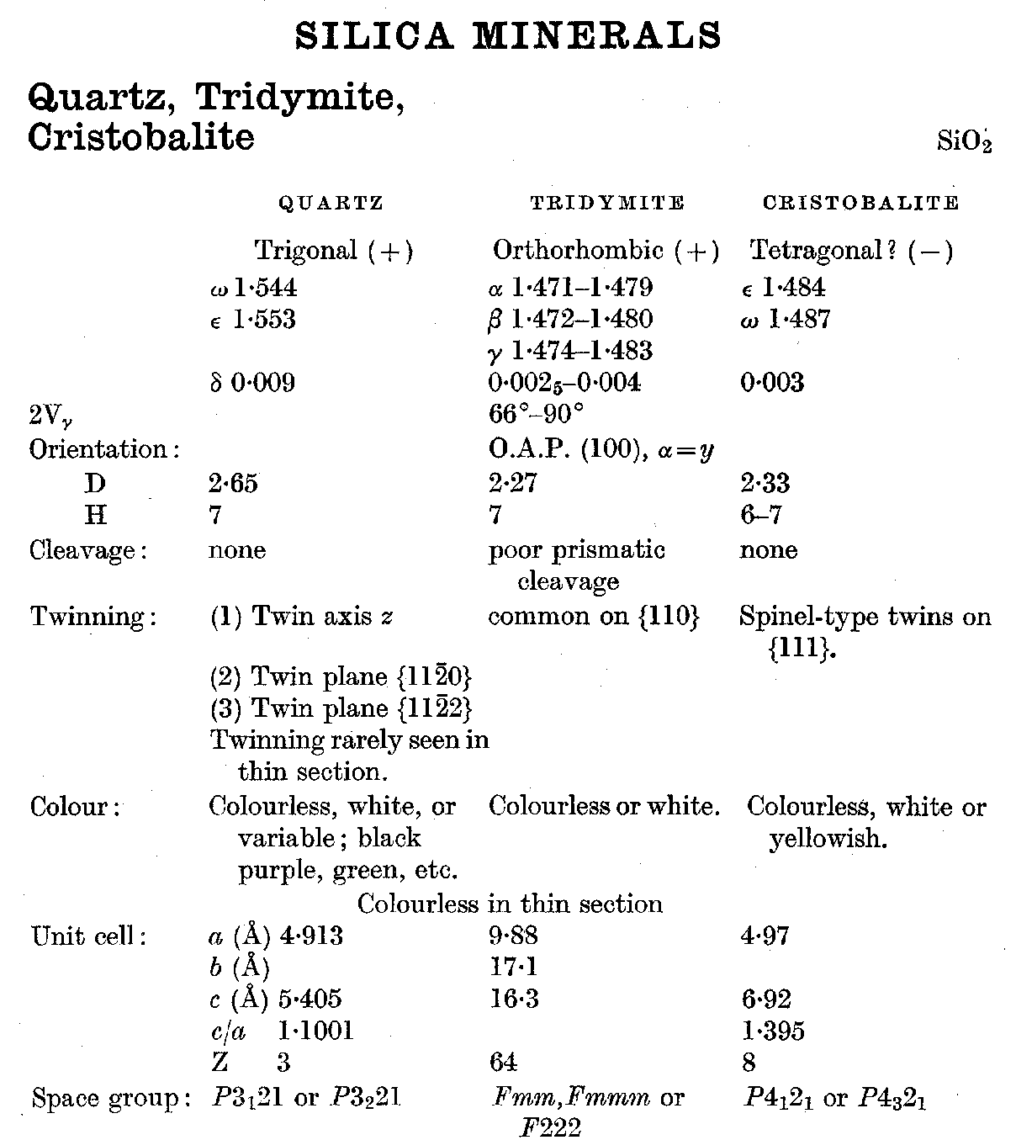
Example: Quartz ω = 1.544 ε = 1.553
1.544
ω
1.553
ε
Data from Deer et al
Rock Forming Minerals
John Wiley & Sons

Slide 19
Example: Quartz ω = 1.544 ε = 1.553
Sign??
(+) because ε > ω
  ε - ω = 0.009 called the birefringence (δ) = maximum interference color (when seen?)
  What color is this?? Use your chart.

Slide 20
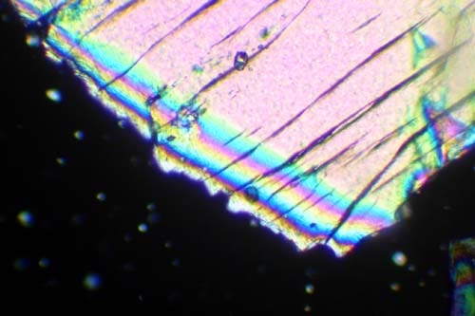
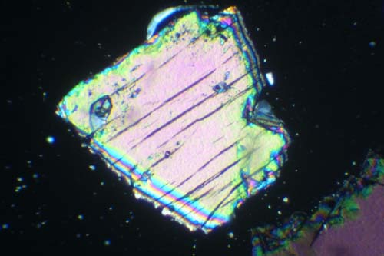
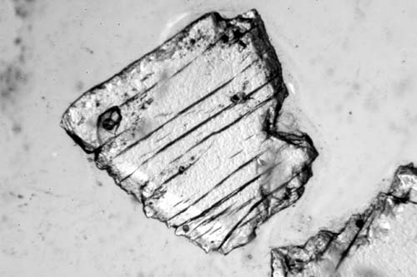
What interference color is this?

Slide 21
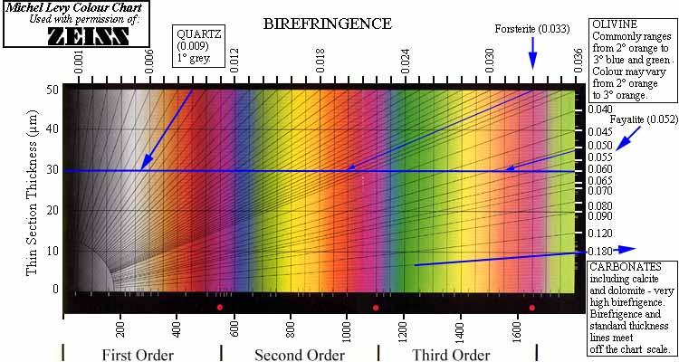
Colors one observes when polars are crossed (XPL)
Color can be quantified numerically: d = n_{high} - n_{low}

Slide 22
Rotation of crystal?
Retardation also affected by mineral orientation!
As you rotate a crystal, observed birefringence colors change
Find maximum interference color for each in practice

Slide 23
Extinction
When you rotate the stage → extinction relative to the cleavage or principle direction of elongation is extinction angle
Maximum interference color → ∆𝛼 → extinction angle

