Slide 1
Physical properties of minerals

Slide 2
Crystal Habit
Crystal habit is the characteristic shape in which a mineral grows. A mineral’s crystal habit results from its crystal system and space group, bond strengths, and growth environment. Crystal habit describes the typical appearance of an ideal mineral specimen. Minerals may not always show their classic habits if they have grown in crowded or disturbed conditions.
Euhedral minerals, having grown in undisturbed, uncrowded settings, display the ideal/typical crystal habit for that particular mineral. Subhedral or anhedral mineral grains are less likely to conform to expected crystal habit, but still often maintain a characteristic appearance.
The names of crystal habits describe the predominant crystal faces (e.g. prismatic, pyramidal, platy, etc.), crystal form (cubic, octahedral, etc.), or the way minerals grow in aggregate (fibrous, radiating, massive, etc.).

Slide 3
Crystal Habit ≠ Crystal form ≠ Quality of shape
Crystal form: a set of crystal faces that are related by symmetry
Crystal habit: typical shape/aspect ratio/granularity of natural crystals, given by descriptive words
Crystal quality: euhedral crystals have “perfect” faces that align well with its crystal form. Subhedral crystals have poorly defined, but identifiable, crysal faces. Anhedral crystals have no identifiable crystal faces
Euhedral, equant pyrite cubes on anhedral, massive chert (quartz)
Tetragonal bipyramidal crystal form

Slide 4
Examples of crystal habits (many more exist!)
acicular: needle-like
botryoidal: globular/rounded
drusy: aggregate, sugary
massive: shapeless/anhedral
platy: thin rectangles
prismatic: elongated, prism-like
sphenoid: wedge-shaped
tabular: rectangular, flat
Notes:
Photos from Wikipedia creative commoms

Slide 5
Crystal Systems
Describes the coordinate system associated with the structure of the mineral’s unit cell
Bravais lattice: arrangement of nodes on a crystallographic coordinate system, over which the unit cell repeats

Slide 6
Crystal Systems
14 Bravais Lattices and 7 Crystal Systems

Slide 7
Color and Streak
Refers to how light is absorbed by the mineral and reflected back to the viewer
Caused by spacing and structure of the crystal lattice
Impurities may change the perceived color of a mineral (e.g. fluorite is colorless but may be purple, blue, etc.)
Streak refers to the color of the powder left by a mineral when it is scratched against an unglazed tile
  Streak may be different than color!
  Streak is both an optical and a mechanical property

Slide 8
Luster
Refers to how the mineral reflects light
  Like color and streak, luster is an optical property related to how the mineral absorbs and reflects light
Luster is an observable representation of several physical properties – how so?
  Index of refraction, n = c/ν
  Density, ⍴ = m/v
  Lattice defects
  Cleavage
  Grain domain size
  etc.

Slide 9
Types of luster
Admantine: superlative luster, like diamond (can see reflection from inside the mineral)
Metallic (splendent): shines like metal
submetallic: similar to metallic, but duller and less reflective (common in near-opaque minerals)
Dull (earthy): little to no luster, due to granulations that scatter light in all directions
Greasy: looks like oil; may also feel greasy to the touch
Pearly: present in minerals with thin, transparent co-planar sheets with perfect cleavage, looks like a pearl
Resinous: look like resin, chewing gum or plastic
Silky: parallel arrangement of fine fibers cause the mineral to appear like woven silk
Vitreous: “glassy”
Waxy: resembles wax (dull shine)

Slide 10
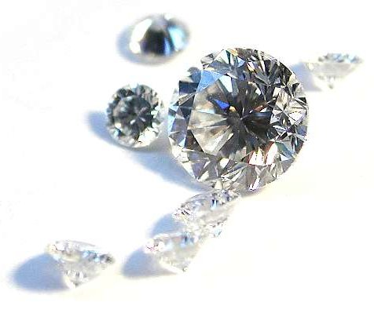
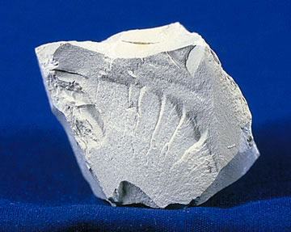
admantine
dull

Slide 11
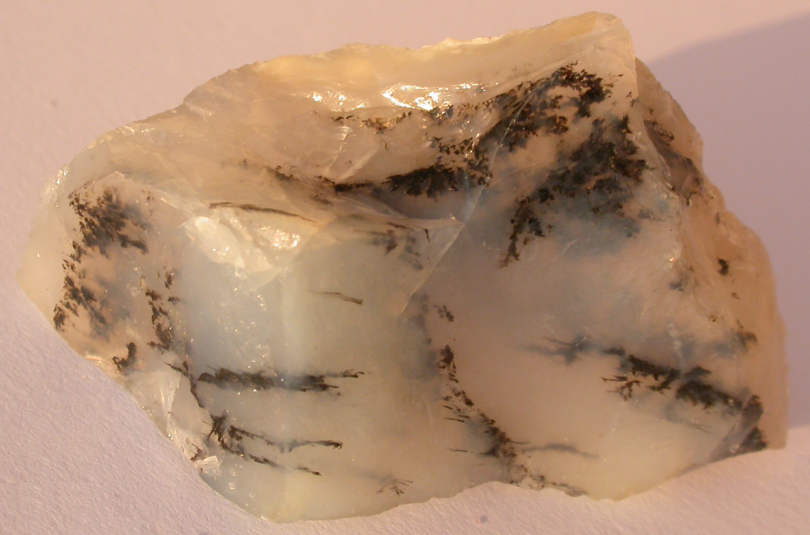
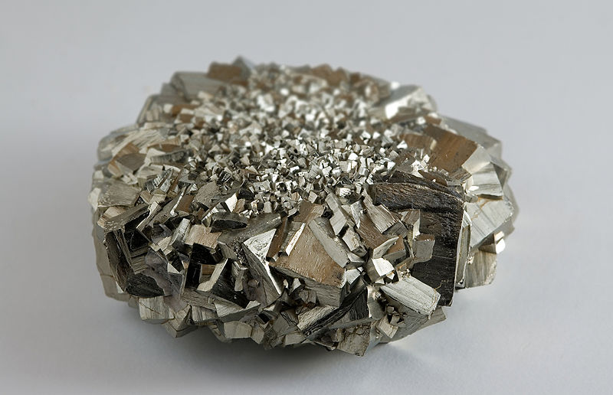
greasy
metallic

Slide 12
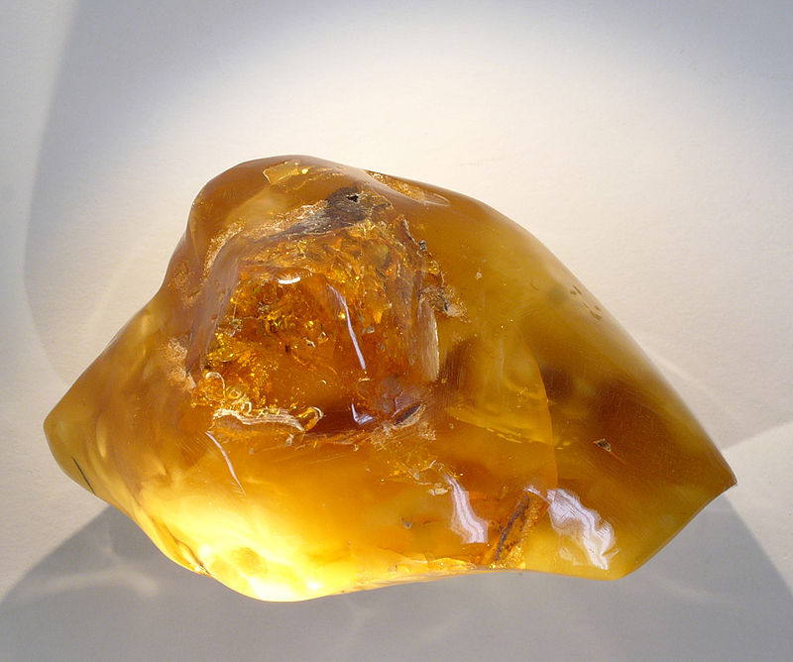
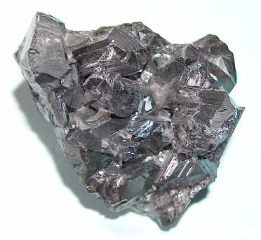
resinous
submetallic

Slide 13
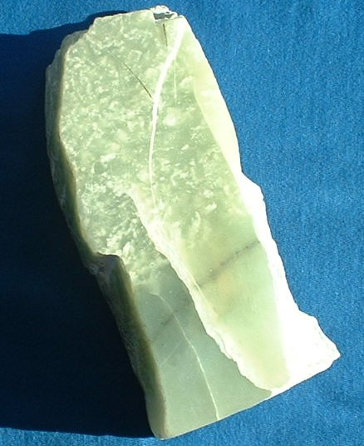
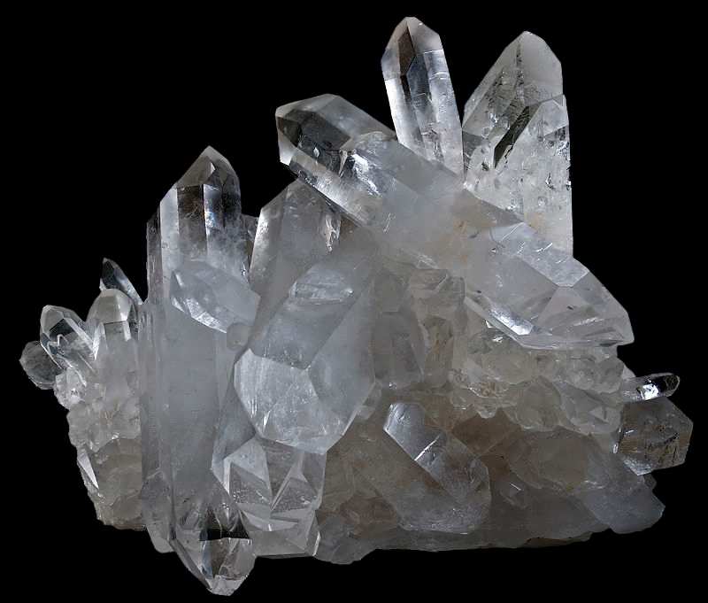
waxy
vitreous

Slide 14
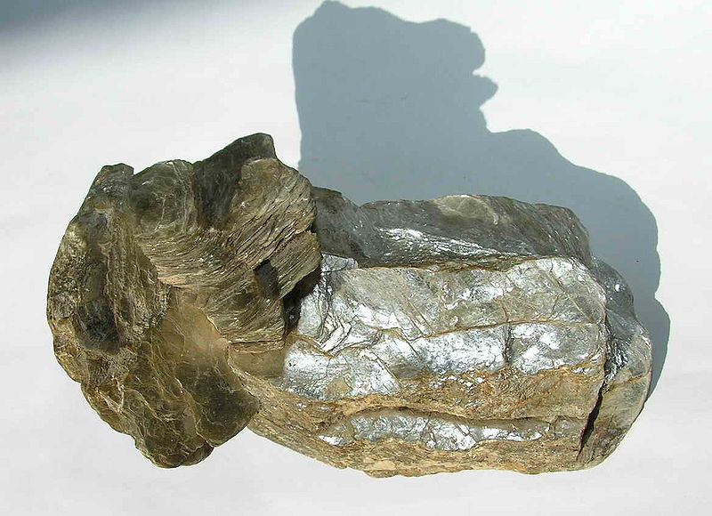
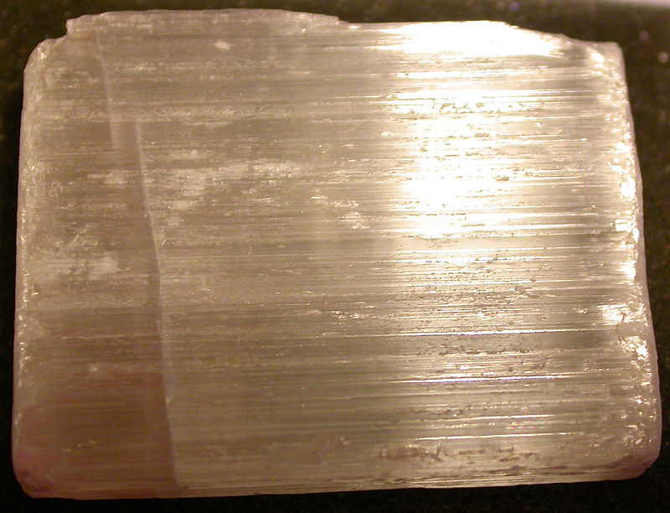
pearly
silky

